Slide 1
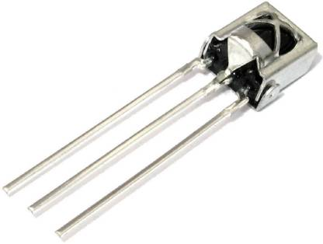
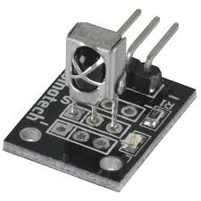
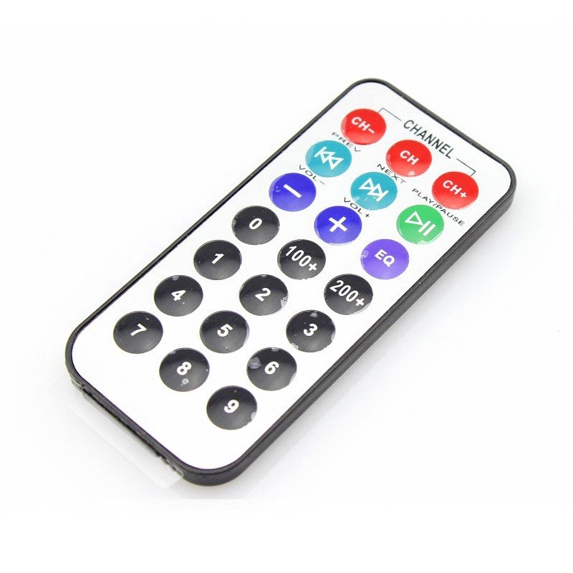
Arduino Session 11
Modulated Signal Communication – IR receiver

Slide 2
How to use IR receiver
Open your tinkercad and search online for how to use the IR receiver

Slide 3
How IR receiver works
The IR receiver outputs HIGH in absence of signal
And outputs LOW in presence of appropriate signal
The appropriate signal is an IR signal with frequency capable of passing through the filter in front of the receiver (usually 38 kHz)

Slide 4
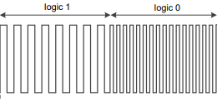
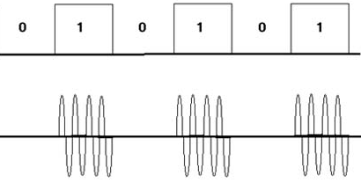
IR Signal Modulation
ASK(Amplitude shift key):
Pulse Position Encoding
Pulse Distance Encoding
Pulse Width Encoding
Manchester Encoding
FSK(Frequency shift key):

Slide 5
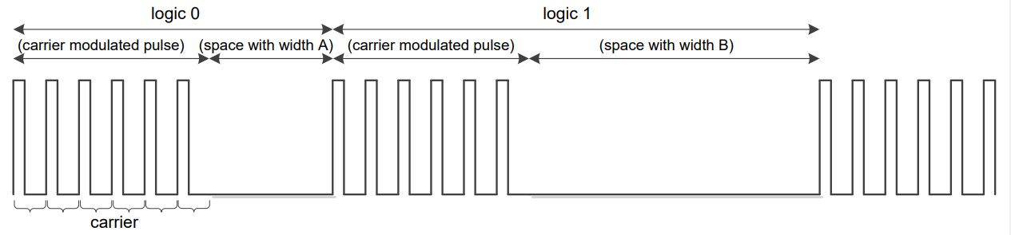
Pulse Distance Encoding

Slide 6
IR signal Demodulation
There is nothing we do for demodulation, the receiver will output a binary demodulated signal

Slide 7
Experimenting with the IR receiver
Open tinkercad.com

